Slide 1
Global E-commerce Sales Analysis (2023-2025)
Power BI Project
Name: Jayshri Chaudhari

Slide 2
Dataset Overview
Source: Kaggle
Data: Orders ID, Customer Name, Products, Sales,
Profit, Discount, Region, Product Category,
Quantity, Payment Method, Shipping Cost
Time Period: 2023-2025
Total Orders: 2K

Slide 3
Tools & Approach
Data cleaning using Power Query
DAX for Calculation
Created KPIs: Sales
Profit
Orders
Profit Margin
Build interactive dashboard with filters

Slide 4
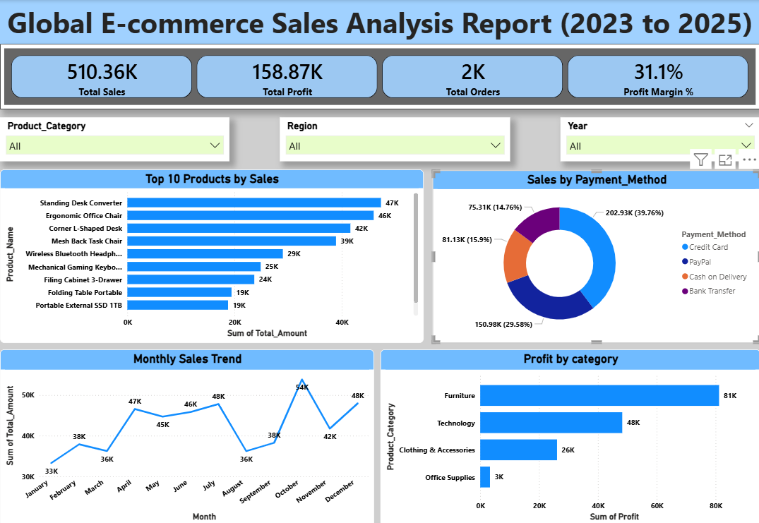
Dashboard Overview
* Top Products * Category
* Sales trend * Payment Methods

Slide 5
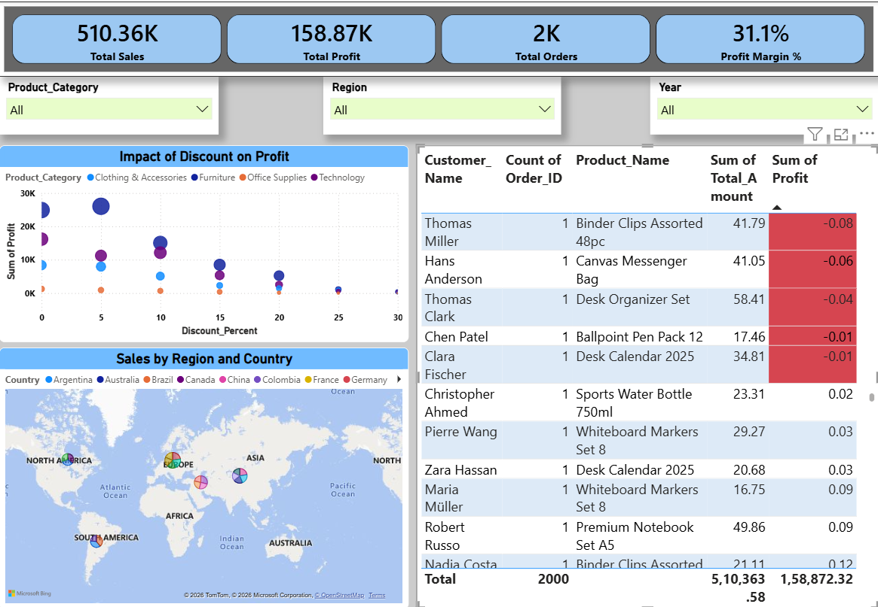
Detailed Analysis
* Discount vs. Profit * Regional sales distribution
* Order-level insights

Slide 6
Key Insights
From the analysis,
Furniture is most profitable
High discounts reduce profit
Some transactions show negative profit
Top regions are Europe and North America
Sales show seasonal trends peak in Oct-Dec

Slide 7
Recommendations
Maximize profit, Not Just Sales
* Control high discount strategies
* Focus on high-profit categories
* Target peak months

Slide 8
Future Scope
In future, this project can be enhanced by:
Adding real-time data and supports live decision-making
Using predictive analysis for sales forecasting
Customer Segmentation
Advanced KPIs for deeper analysis

Slide 9
Conclusion
Understood Sales Performance
Increasing Profitability
Support better data driven decision-making

Slide 10
Thank You

